Slide 1

HUMAN-CENTERED DESIGN
Dr. Nadeem Ahmad Ch.
Associate Professor, University of Central Punjab, Lahore Pakistan
Dual PhD in Computer Science (Italy & Germany)
18 years teaching, research & administration experience
24 International research publications
Head of people centered technology research group
Former Pro Vice Chancellor/ Professor of computing, University of Sialkot
Former Chairman CS department, The Superior university, Lahore
Former head of CS & IT department, The University of Lahore
Notes:
1

Slide 2
Table of Contents
Human-Centered Design (HCD)
Importance of HCD
HCD key phases
Methods involved in different HCD phases

Slide 3
Learning Outcomes
You will learn design thinking process and will understand that how HCD is helpful in providing innovative and out of box solutions.
By putting yourself in situation of end user, will reveal new knowledge and thrust to resolve their issues.
You will understand key phases of HCD and will be able to apply them in your own projects.
You will able to synthesize the knowledge exposed by understanding different methods involved in key phases of HCD.

Slide 4
Gulfs of execution and evaluation
Norman, 1986; Hutchins et al, 1986
The ‘gulfs’ explicate the gaps that exist between the user and the interface
The gulf of execution
  the distance from the user to the physical system
The gulf of evaluation
  the distance from the physical system to the user
Bridging the gulfs can reduce cognitive effort required to perform tasks
Notes:
4

Slide 5
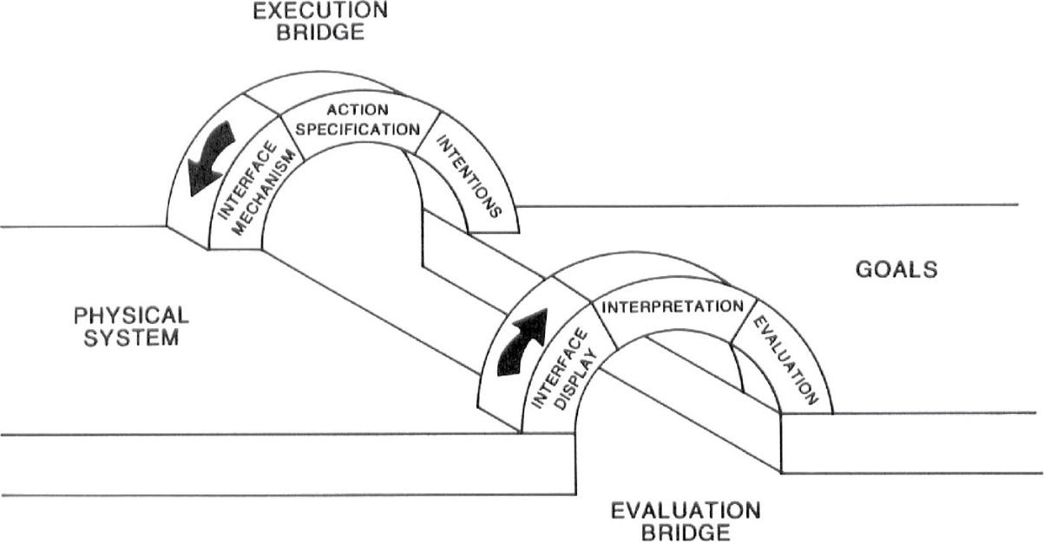
Bridging the gulfs
Notes:
Figure 3.8

Slide 6
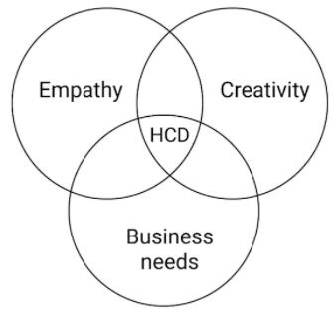
Human-Centered Design
Human-Centered Design (HCD) is an approach to problem-solving used in design, management, and engineering frameworks by involving the human perspective in all steps of the problem-solving process.
Human-centered design is all about building a deep empathy with the people you’re designing for; generating many ideas; building relevant prototypes; sharing with stakeholders and revealing your innovative solutions.

Slide 7
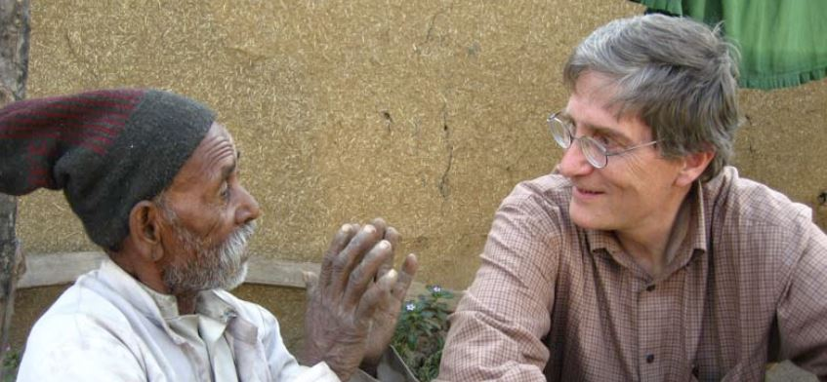
Human-Centered Design
Two important steps in HCD:
Observing user behavior: Try to understand people’s requirements by observing them.
For example, if you’re designing an application for farmers, you should observe them in real scenario.
Putting yourself in the situation of the end-user: Try to understand what the user experience is really like; to feel what their users feel.

Slide 8
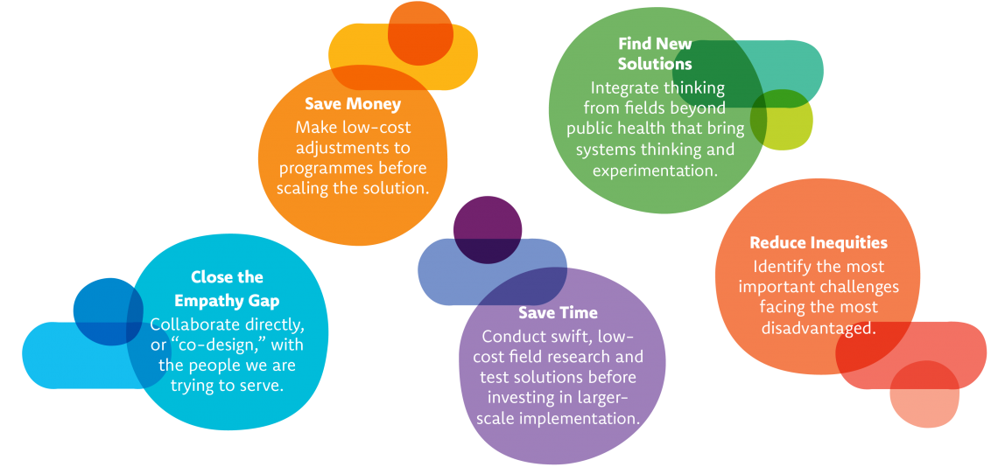
Why Human-Centered Design Matters?

Slide 9
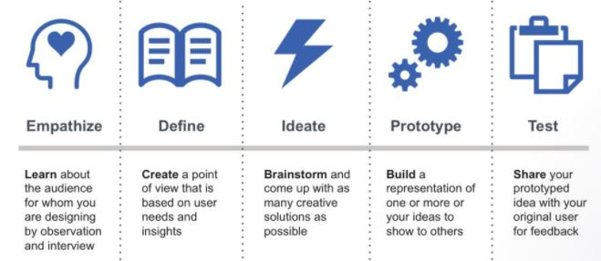
Human-Centered Design Key Phases
Human-Centered Design process has many forms, the model presented by Stanford University, Design School has 5 key phases.

Slide 10
Empathize—Research Your Users' Needs
It involves learning about the difficulties people face, as well as uncovering their latent needs and desires in order to explain their behaviours.
Deep understanding of the problems and realities of the people you are designing for..
Empathise methods
–Assume a beginner’s mindset –Ask What-How-Why
–Conduct interviews with empathy
–Build empathy with analogies –Use photo and video user-based studies
–Use personal photo and video journals –Engage with extreme users
–Story share-and-capture –Create journey maps

Slide 11

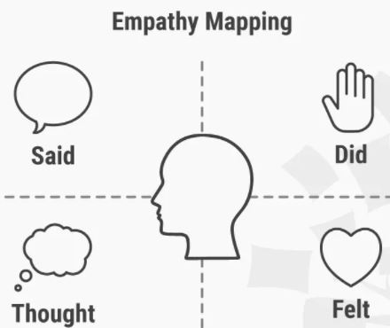
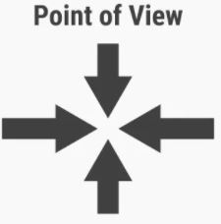
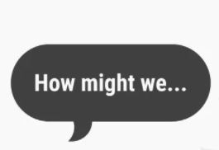
Define—State Your Users' Needs and Problems
After empathy, you analyze your observations and synthesize them to define the core problem.
Define methods
Space Saturate and Group Empathy Mapping Point of view How Might We
Actionable Statements

Slide 12
Ideate—Challenge Assumptions and Create Ideas
Ideation is the process where you generate ideas and solutions through sessions such as Sketching, Prototyping, Brainstorming, Worst Possible Idea, and a wealth of other ideation techniques.
Ideation Will Help You:
Step beyond the obvious solutions and therefore increase the innovation potential of your solution.
Bring together perspectives and strengths of your team members.
Uncover unexpected areas of innovation.
Create volume and variety in your innovation options.
Get obvious solutions out of your heads, and drive your team beyond them.

Slide 13
Characteristics for Successful Ideation
Adapting: Be able to switch how you see, understand, and extend thinking as new input gets generated.
Connecting: Be able to connect seemingly unrelated concepts in order to create new possibilities.
Disrupting: Be able to overturn commonly held in order to re-think conventional approaches.
Flipping: Turn deadlocks into opportunities or rapidly changing direction towards greater viability.
Dreaming and Imagining: Be able to visualise a new picture of reality by turning abstract needs into tangible pictures. .
Experimental: Be open and curious enough to explore possibilities and take risks.
Recognise Patterns: Seek to spot common threads of meaning, and ways of seeing, doing and behaving across a spectrum of influence and input; and finally be able to utilize these commonalities to build solutions.
Curiosity: Be willing to explore and experience, in order to understand and learn something new and different.

Slide 14
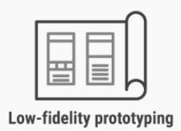
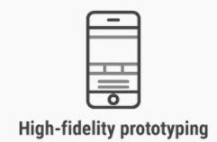
Prototype—Start to Create Solutions
This method involves producing an early, inexpensive, and scaled down version of the product in order to reveal any problems with the current design.
Prototyping offers designers the opportunity to bring their ideas to life, test the practicability of the current design, and to potentially investigate how a sample of users think and feel about a product.
Storyboarding
Sketching
Card Sorting
'Wizard of Oz'

Slide 15
Prototyping
What is a prototype?
Why prototype?
Evolutionary vs. throwaway prototype
Low vs. high fidelity prototyping

Slide 16
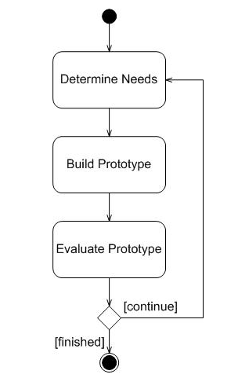
Prototype
A prototype is an early sample, model, or release of a product built to test a concept or process or to act as a thing to be replicated or learned from

Slide 17

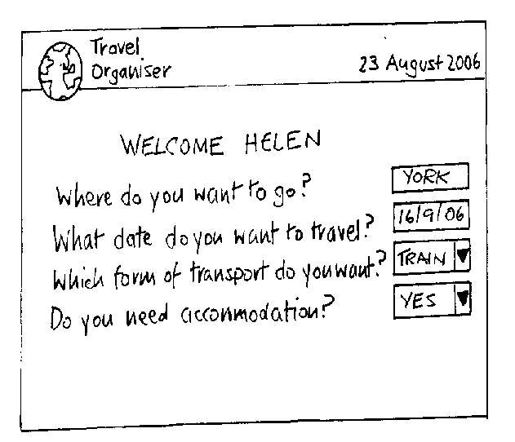
What is a prototype?
Limited representation of a product design
Scale models, etc.
In interaction design it can be (among other things):
  a series of screen sketches
  a storyboard, i.e. a cartoon-like series of scenes
  a piece of software with limited functionality
Notes:
The most familiar scale models represent the physical appearance of an object in miniature,

Slide 18
Why prototype?
People cannot describe what they want, but they are quick to recognize what they do not like!
Makes requirements, designs and specifications into concrete tangible objects for evaluation

Slide 19
Why prototype?
Evaluation and feedback are central to interaction design
Stakeholders can see, hold, interact with a prototype more easily than with a document
Clarifies vague requirements with concrete communication between stakeholders
Team members can communicate effectively
You can test out ideas for yourself
Prototypes answer questions, and support designers in choosing between alternatives
Notes:
Interactive exploration with envisioned product
Clarifies vague requirements with concrete communication between stakeholders
supports design decisions with forced reflection
Tests feasibility & compatibility
Sells product ideas

Slide 20
What to prototype?
Work flow, task design, sequence i.e. in the order they happen
Screen layouts and information display i.e. icons, home buttons, back buttons, colors etc.
Critical areas i.e. Undo button, help, exit, stop etc.
Every thing you need to convey the product experience (but no more)

Slide 21
Prototyping Techniques
Throw away prototyping (rapid prototyping)
  Prototype developed as part of a throw-away approach
Evolutionary prototyping ( Rapid Application Development (RAD))
  as for incremental prototyping but with evolving design

Slide 22
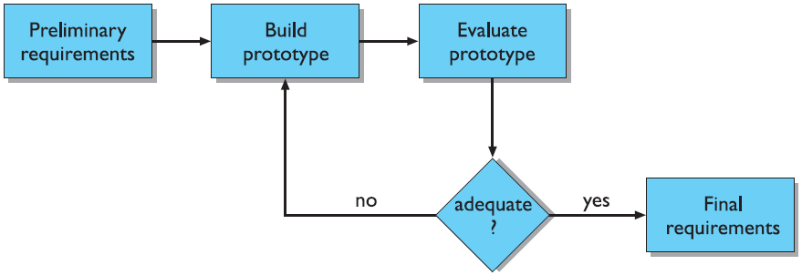
Throw-away / Rapid Prototyping
Prototype developed as part of a throw-away approach.
It will not form part of the final solution.
It is a useful way of exploring ideas, and gaining feedback from user.

Slide 23
Evolutionary Prototyping
An initial prototype is presented to user.
They provide feedback and suggestion for improvement.
Each stage of this prototype evolves toward the final system hence it is called as evolutionary prototype.

Slide 24
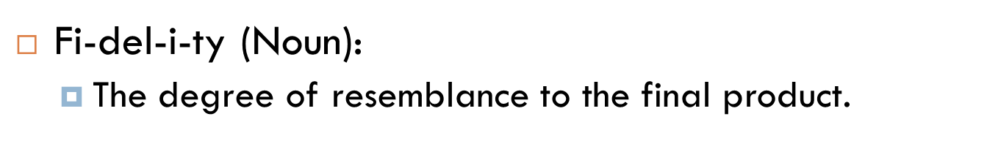
Prototype fidelity
Low fidelity
High fidelity
Quick, cheap, easily changed
Paper based
  Sketches of screens with post-it notes (task sequences)
  Card-based
  Storyboards
Is usually computer based
Prototype looks more like the final system than a low-fidelity version.
Usually include mouse/keyboard interaction
Notes:
The degree of exactness with which something is copied or reproduced.

Slide 25
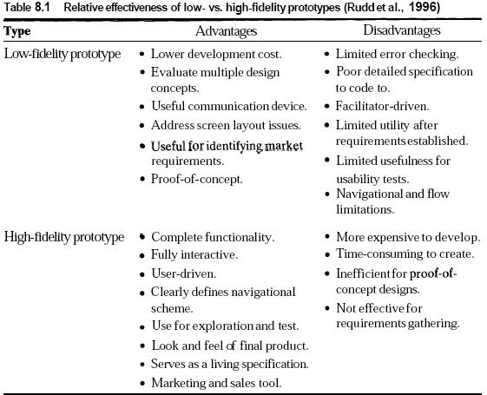
Prototype fidelity

Slide 26
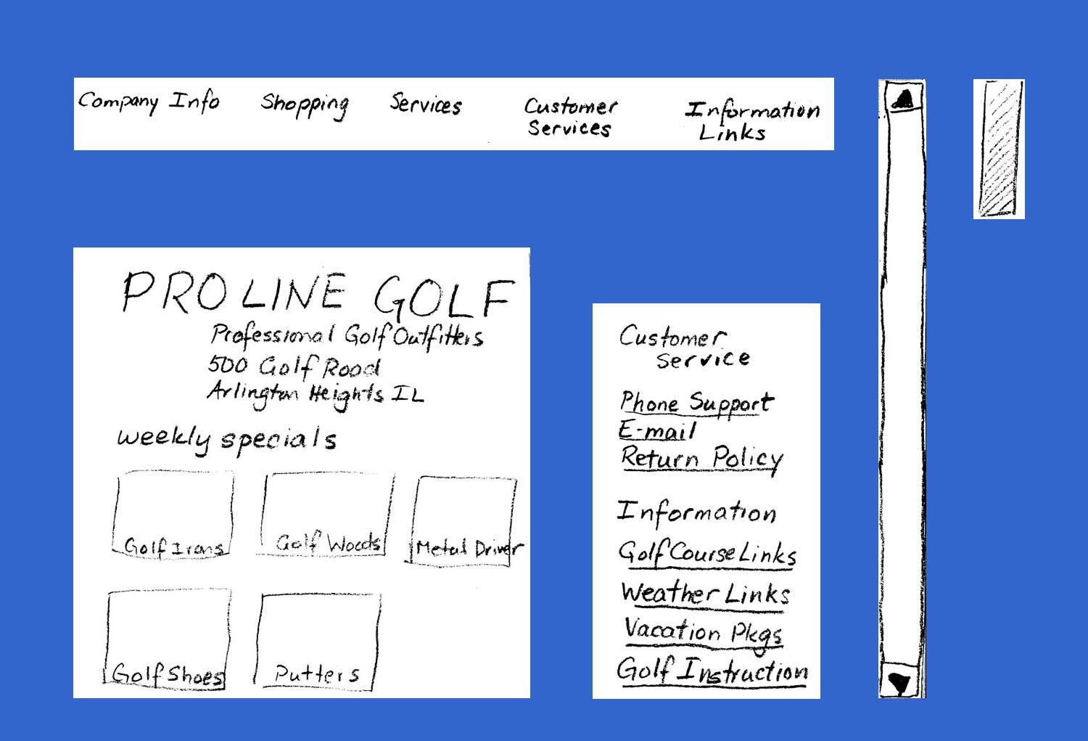
Low fidelity: An Example
Menu Bar
Scroll
Bar
Opening Contents
Secondary Menu

Slide 27
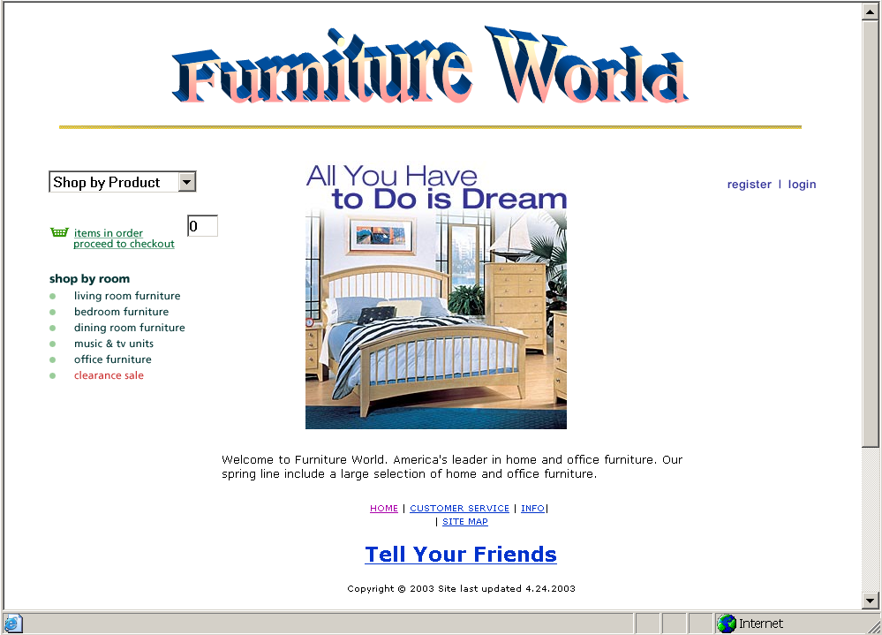
High fidelity: An Example

Slide 28
Why lo-fi is often better than hi-fi
At least in the early stages of design…
  Hi-fi prototypes can be problematic
    users can often think it’s the real thing
    users tend to focus on small details (e.g. font size) rather than the bigger picture
    developers get over-attached having done the programming
  Lo-fi prototypes avoid these issues...
    easy to change
    users concentrate on big picture (e.g. structure and function)
    it’s disposable
So before investing in hi-fi, we need to get lo-fi versions right

Slide 29
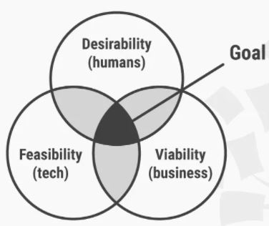
Stage 5: Test—Try Your Solutions Out
Testing can be undertaken throughout the progress of a Design Thinking project.
If users experience difficulties, then the design team must revisit their list of potential solutions.
Testing Guidelines
Let your users compare alternatives
Show, don’t tell: let your users experience the prototype
Ask users to talk through their experience
Observe
Ask follow up questions
Negative Feedback is Your Way to Learn and Improve

Slide 30
Thank You!

